Slide 1
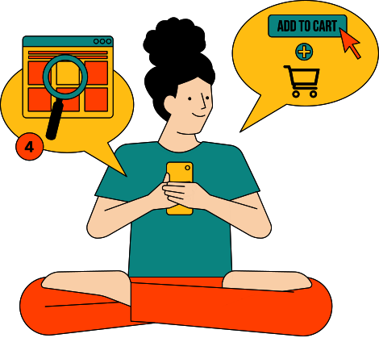



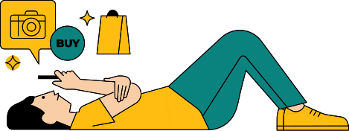
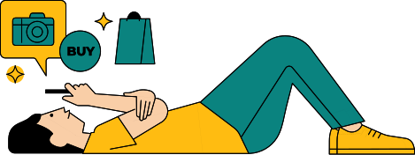
Shruti Gawde
SALES PERFORMANCE ANALYSIS OF WALMART STORES
Using Advanced MySQL Techniques

Slide 2
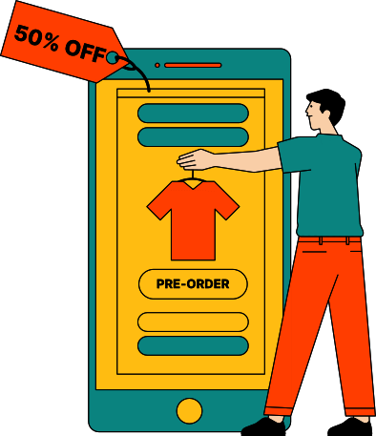
(02)
INTRODUCTION
This project aims to analyze Walmart sales data to extract key insights on sales trends, customer segmentation, and repeat customer behavior using advanced SQL queries.

Slide 3
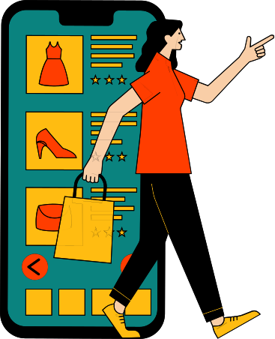
(03)
BUSINESS PROBLEM
Walmart wants to improve customer retention and optimize sales strategies
By identifying repeat customers analyzing sales patterns, and segmenting customers the company can develop targeted marketing strategies.

Slide 4

RESEARCH OBJECTIVES
(04)
Objective 1:
Analyze Walmart's sales data to identify key revenue drivers.
Objective 2:
Segment customers based on spending patterns and retention rates.
Objective 3:
Identify the best-performing product lines across different branches.
Objective 4:
Evaluate the impact of digital payments on sales trends.
Objective 5:
Provide data-driven recommendations to improve sales and customer retention.

Slide 5
HYPOTHESIS
(05)
Hypothesis 1:
Repeat customers contribute significantly to total sales.
Higher customer retention leads to increased profitability.
Hypothesis 2:
Certain product lines perform better in specific locations.
Sales trends are influenced by customer demographics and spending behavior.
Hypothesis 3:
Digital payment methods impact customer purchase frequency.
Customers using E-wallets spend more compared to cash users.

Slide 6
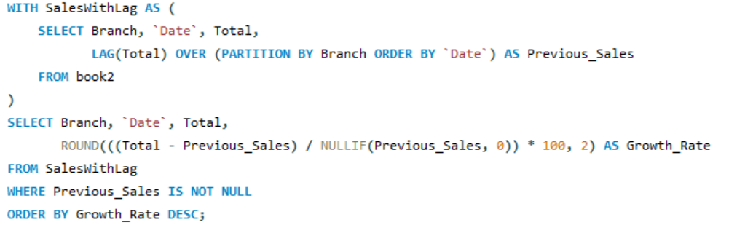
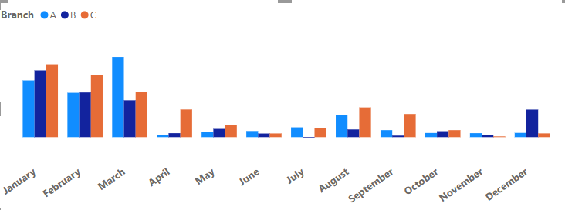
Identifying the Top Branch by Sales Growth Rate
(06)

Slide 7
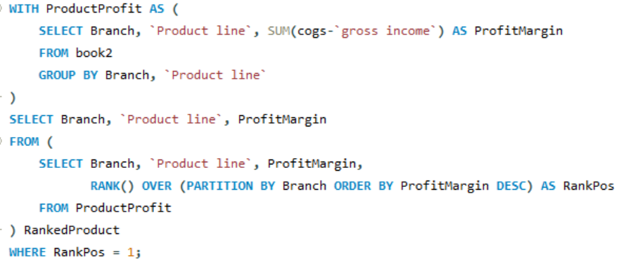
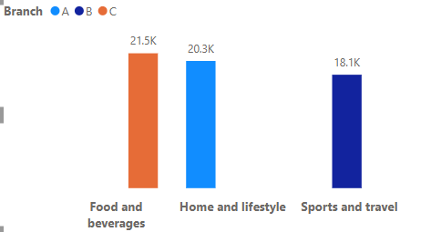
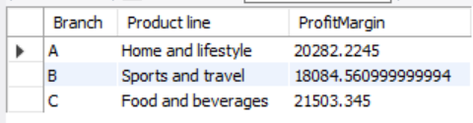
Finding the Most Profitable Product Line for Each Branch
(07)

Slide 8
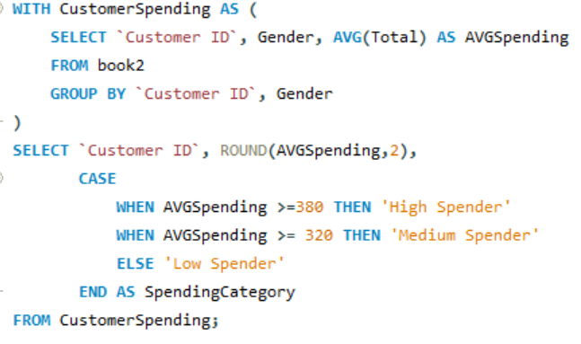
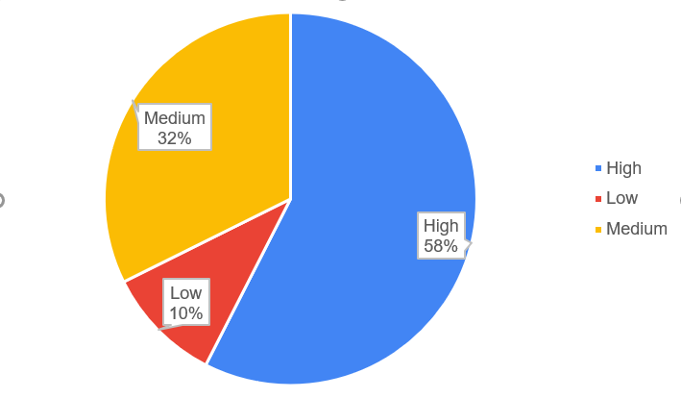
Analyzing Customer Segmentation Based on Spending
(08)

Slide 9
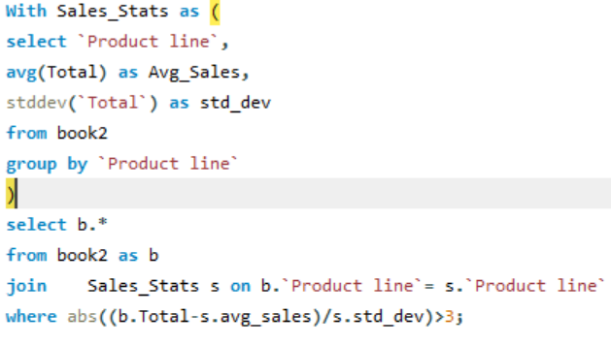
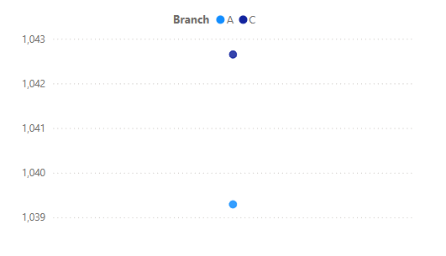
Detecting Anomalies in Sales Transactions
(09)

Slide 10
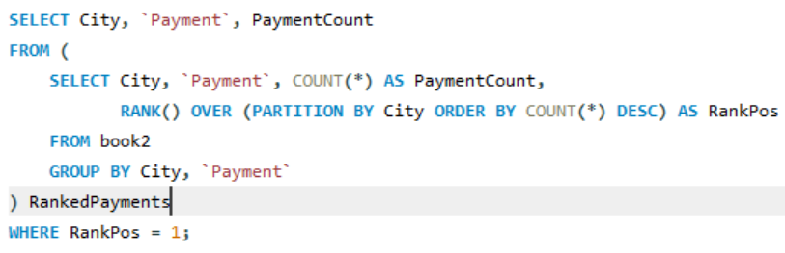
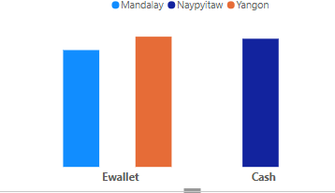
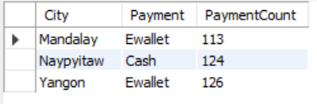
Most Popular Payment Method by City
(10)

Slide 11
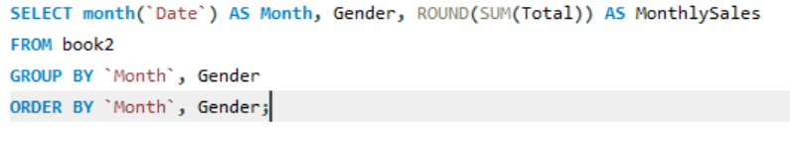
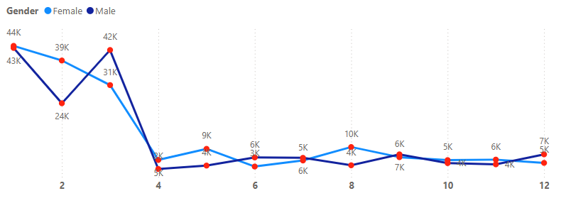
Monthly Sales Distribution by Gender
(11)

Slide 12
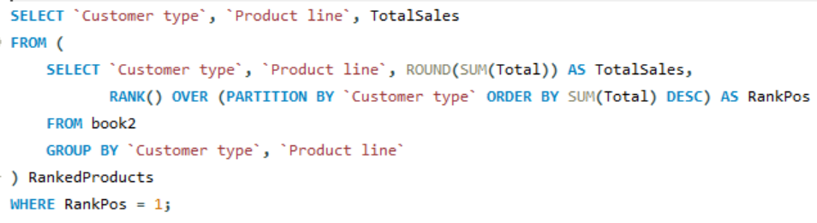
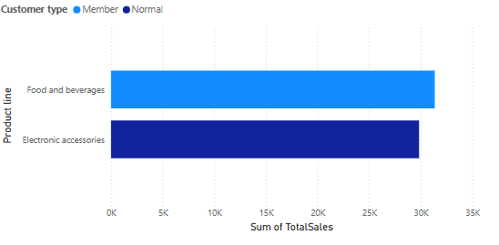
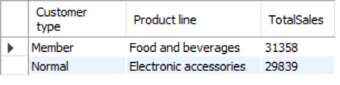
Best Product Line by Customer Type
(12)

Slide 13
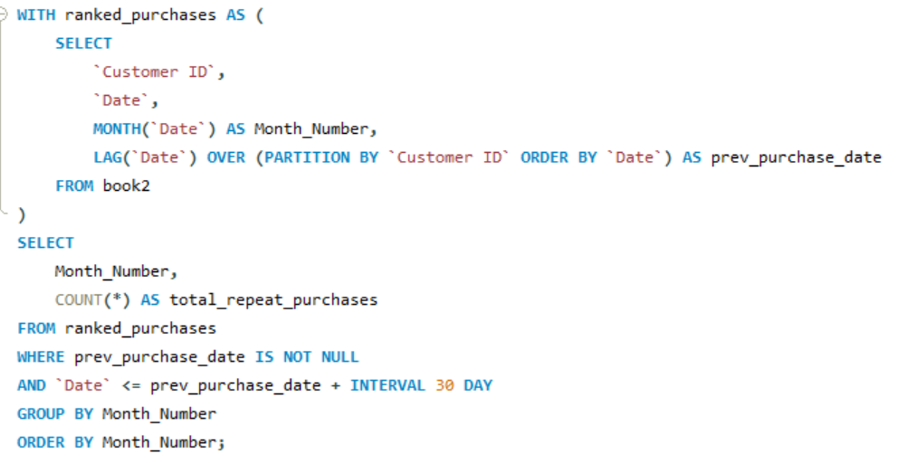
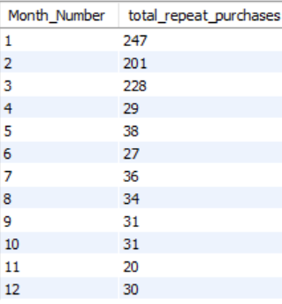
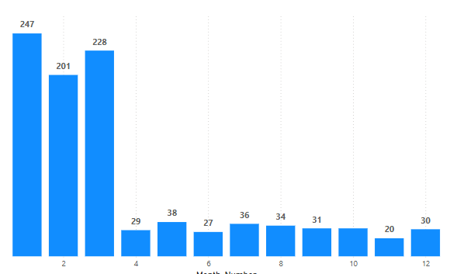
Identifying Repeat Customers
(13)

Slide 14
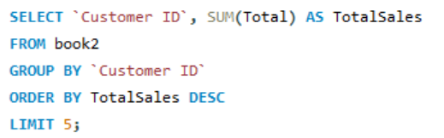
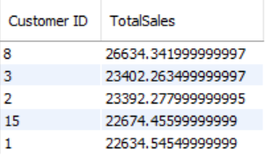
Finding Top 5 Customers by Sales Volume
(14)

Slide 15
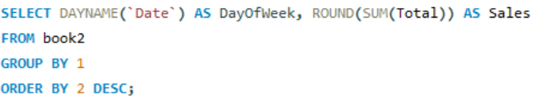
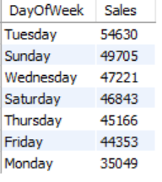
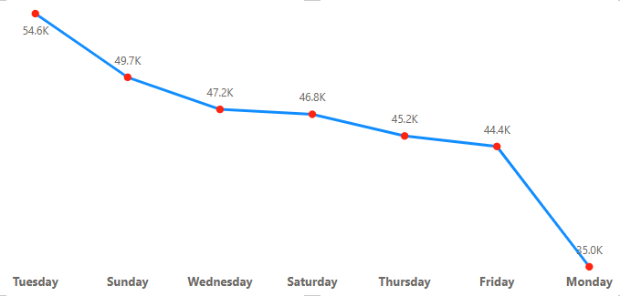
Analyzing Sales Trends by Day of the Week
(15)

Slide 16
Key Findings on Branch C,A and B Performance:
(16)
1.Total Sales:
Branch C leads with $110,568, which is slightly higher than Branch A ($106,200) and Branch B ($106,197).
Branch C is consistently ahead.
2.Average Customer Rating:
Branch C has the highest rating (7.07), suggesting better customer satisfaction.
Branch A follows closely (7.02), while Branch B has the lowest (6.81).
3.Average Quantity Sold per Transaction:
Branch C sells the highest average quantity (5.58 units per transaction), slightly more than Branch A (5.46) and Branch B (5.48).
4.Total Profit:
Branch C generates the highest profit ($5,265), while A and B make around $5,057 each.
Preliminary Conclusion:
Branch C is performing better due to higher sales volume and slightly better customer satisfaction.
Its higher profit and quantity sold per transaction indicate better product demand or marketing strategies.
Branch C is in Naypyitaw which is the capital of Myanmar that could be reason it has more High end customers.

Slide 17

Recommendations to increase the sales
01
Improve Underperforming Categories
Branch A: Increase promotions for Health & Beauty products to boost sales.
Branch B: Offer discounts or bundles on Home & Lifestyle products to attract more buyers.
02
Leverage Seasonal Trends
Focus on May and December to maximize sales by offering targeted promotions and premium product discounts.
Use festivals and holiday seasons to drive traffic through special campaigns
Enhance Customer Engagement
03
Offer loyalty programs to encourage repeat purchases, especially from premium customers.
Use personalized offers based on previous purchase patterns to increase conversion rates.
04
Optimize Store Hours & Promotions
Evening hours (6 PM - 7 PM) are peak business hours; introduce flash sales or limited-time discounts.
Promote fashion accessories at 3 PM and food & beverages at 7 PM to maximize engagement.

Slide 18
Recommendations to increase the sales
05
Improve Customer Satisfaction
Branch C has the highest customer rating (7.07). Other branches should focus on improving customer service and product availability.
Offer a smooth checkout experience, especially during peak hours.
06
Expand Digital Payment Promotions
E-wallet usage peaks at 7 PM, indicating a preference for digital transactions. Promote cashback or rewards for E-wallet users to encourage higher spending.
07
Targeted Marketing Campaigns
Mandalay: Focus on travel-related products due to tourism demand.
Yangon: Increase the availability of lifestyle and fashion products as they perform well in urban settings.
Naypyitaw: Offer premium products in food & beverages and electronic accessories to cater to high-income customers, also can offer lunch time deal to office workers and students.

Slide 19
THANK YOU!
Video link https://drive.google.com/file/d/1FcMiQwhP_DLneZt-V_AbgfB0ZA03MTpt/view?usp=sharing

